Slide 1


NEXT GEN EMPLOYABILITY PROGRAM
CREATING A FUTURE-READY WORKFORCE
Student Name :
SAHIL HARISHCHANDRA MAURYA
Student ID :
College Name :
vu1f2223094@pvppcoe.ac.in
VASANTDADA PATIL COLLEGE OF ENGINEERING
STU679713deb08891737954270

Slide 2
CAPSTONE PROJECT SHOWCASE
Project Title
FINANCE MANAGER
Abstract | Problem Statement | Project Overview | Proposed Solution | Technology Used | Modelling & Results | Conclusion | Q&A

Slide 3
Abstract
1
Purpose: The Finance Manager app is designed to help individuals and businesses efficiently track and manage their financial activities, providing insights into spending, budgeting, and investments.
2
Core Features: The app includes features like expense tracking, budget management, financial reports, and data visualization tools for better decision-making.
3
Technology Stack: Built using the MERN stack (MongoDB, Express.js, React.js, Node.js), ensuring a scalable, responsive, and secure solution.
4
Target Audience: Aimed at individuals, small businesses, and anyone looking for a user-friendly yet powerful tool to manage finances and track financial goals.

Slide 4


Problem Statement
Current Challenge: Managing personal or business finances can be cumbersome, with many users relying on manual tracking methods or basic tools that lack the necessary functionality for detailed financial planning.
Gap in the Market: Existing solutions are either too complex, hard to use, or lack essential features like budget planning, real-time tracking, and financial analytics.
Objective: Develop a user-friendly, accessible solution that simplifies financial management while offering robust features for both individuals and businesses.

Slide 5

Project Overview
Goal: Create a web application that helps users
manage their finances through efficient tracking and budgeting tools, real-time updates, and intuitive interfaces.
Core Components:
Backend: Node.js and Express.js for building a RESTful API to handle user data and transactions.
Frontend: React.js for an interactive and responsive user interface.
Database: MongoDB to store financial records and user data securely.
Target Audience: Individuals, small businesses, or anyone needing a comprehensive finance management tool.

Slide 6
Proposed Solution
User Features:
Expense Tracking: Categorize and track daily expenses.
Budget Management: Set up monthly/annual budgets and monitor spending patterns.
Authentication & Security: Secure login using JWT and session management.
Responsive Design: Mobile-friendly for accessibility on all devices.

Slide 7
Technology used
MongoDB: NoSQL database to store and manage user and transaction data.
Express.js: Framework to simplify API development and server-side logic.
React.js: Library for building a dynamic, single-page user interface.
Node.js: Server-side runtime for handling requests and responses efficiently.
JWT: For secure user authentication.

Slide 8

Modelling & Result

Slide 9
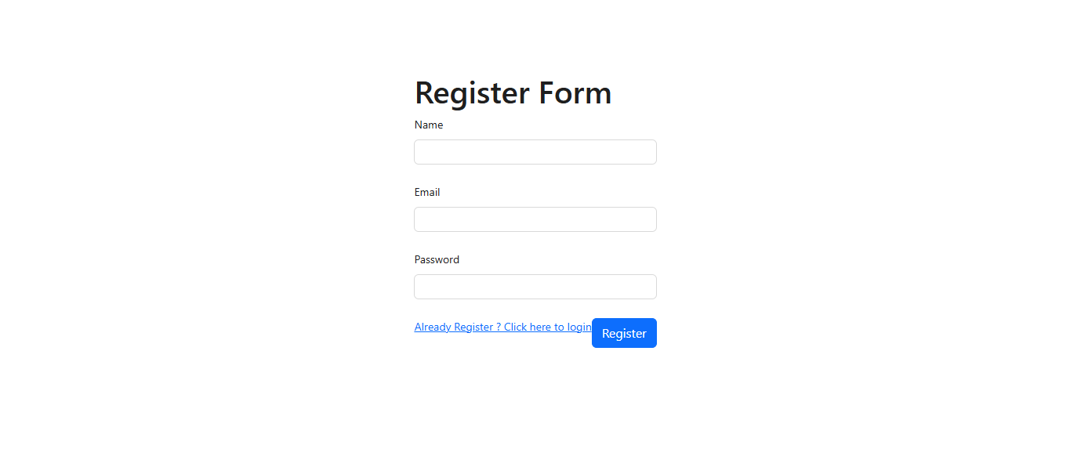
Modelling & Result

Slide 10
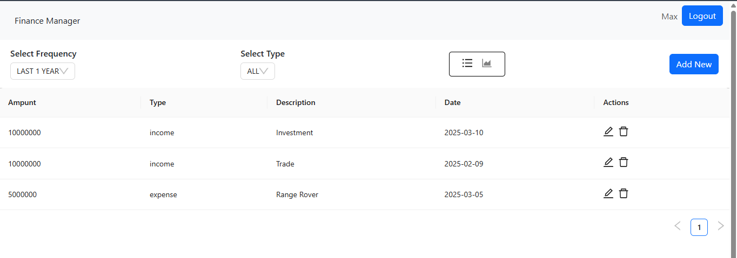
Modelling & Result

Slide 11
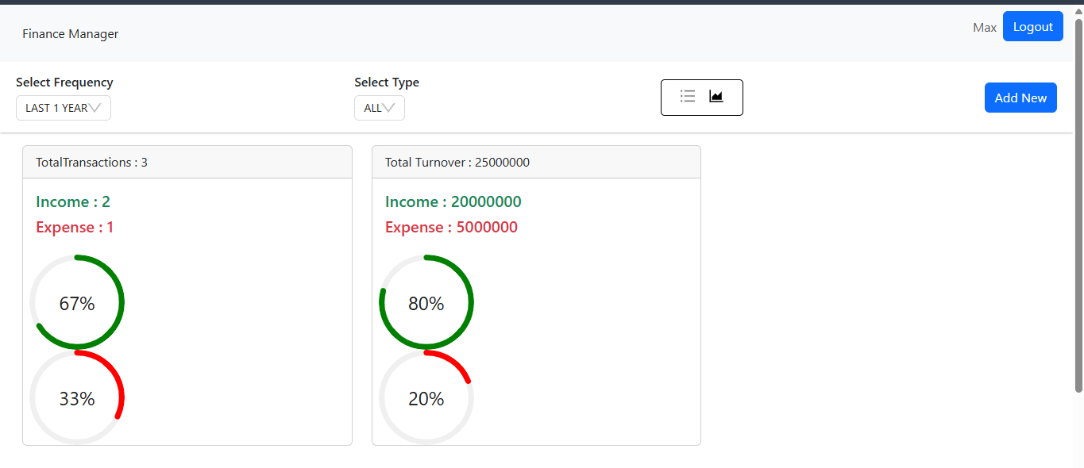
Modelling & Result

Slide 12

Conclusion
Summary: The Finance Manager app successfully addresses the need for a comprehensive, easy-to-use financial management tool. Built with the MERN stack, it provides a scalable, responsive, and secure solution for both individuals and businesses.
Future Enhancements:
Mobile app version for on-the-go access.
Integration with third-party APIs (e.g., bank account syncing, investment tools).
Advanced AI features for predictive budgeting and investment analysis.
Final Thoughts: This app provides a foundation for managing finances, and future updates will continue to improve the user experience and functionality.

Slide 13


Notes:
Thank You !!

